Slide 1
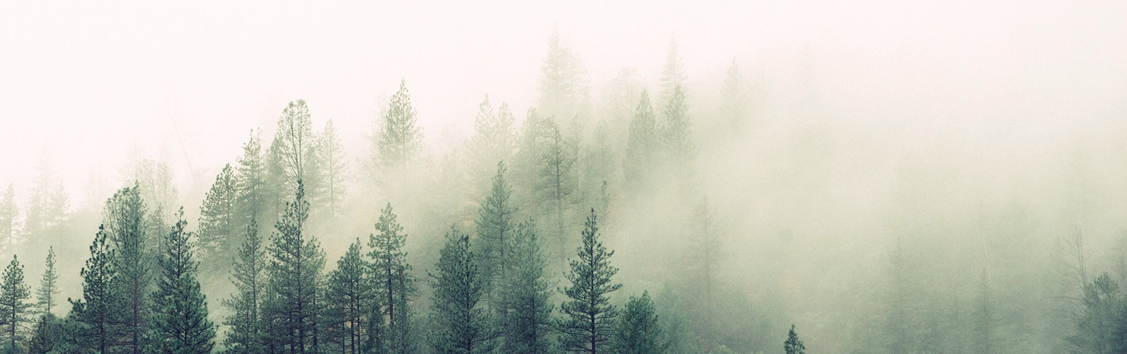
FOREST COVER CLASSIFICATION
By Shiping Li

Slide 2
Why classify forest cover types?
Forest provides many foods and services.
Develop strategies for forest maintenance
Reconstruct pre-settlement forest structure and distribution
Provide scientific basis for the future forest study.
Notes:
2. food: timer product, fuel, seed, fruit,
service: providing oxygen, purifying air, enhancing climate, conserving water, preserving soil, and supporting wildlife.

Slide 3
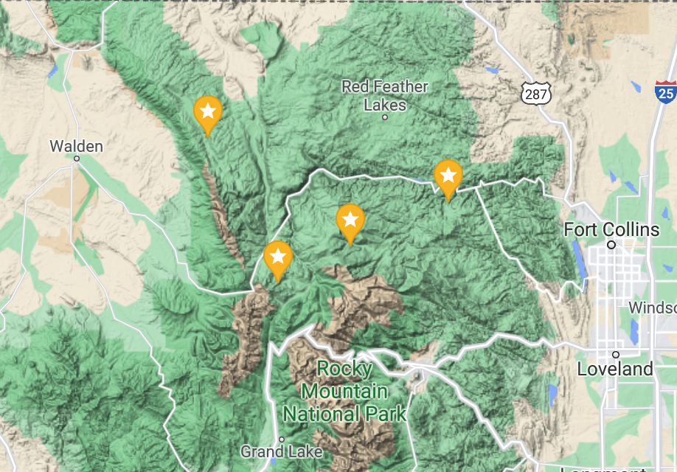
Objective
The objective of the project is to classify 7 forest cover types.
Roosevelt National Forest of northern Colorado
Rawah Wilderness
Cache la Poudre Wilderness
Comanche Peak Wilderness
Neota Wilderness
Map source: https://maps.google.com

Slide 4
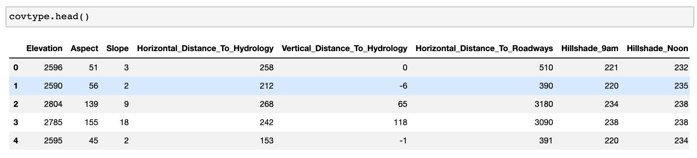
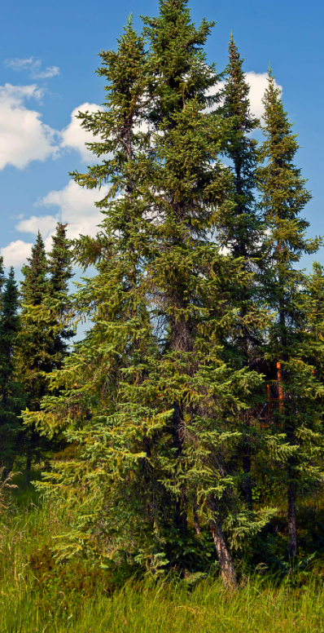
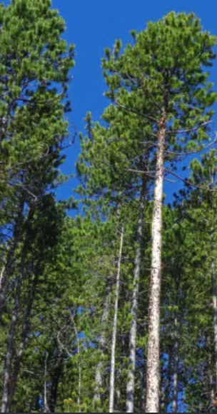
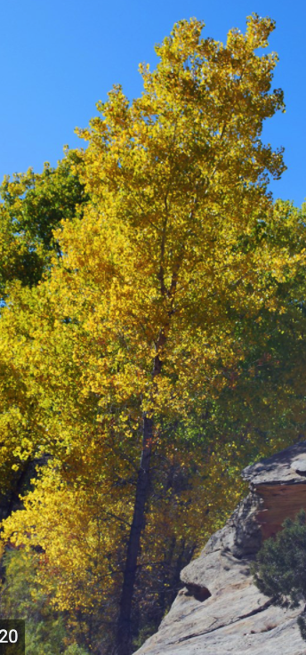
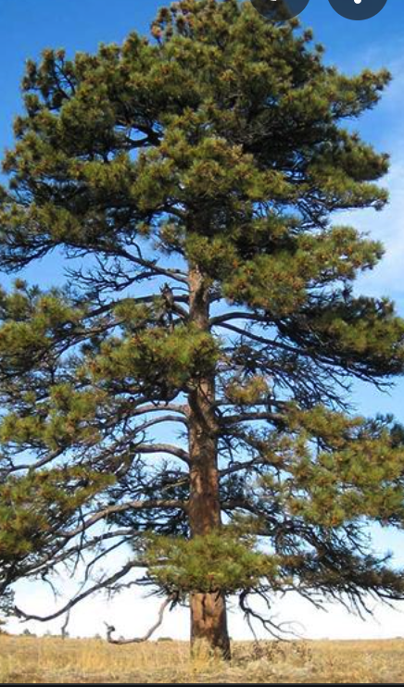
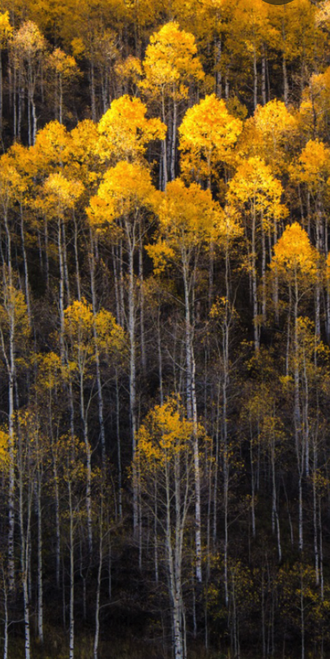
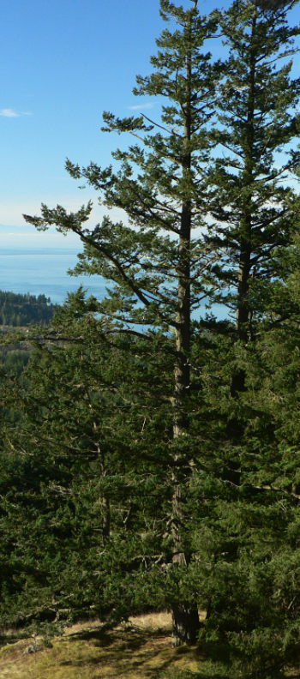
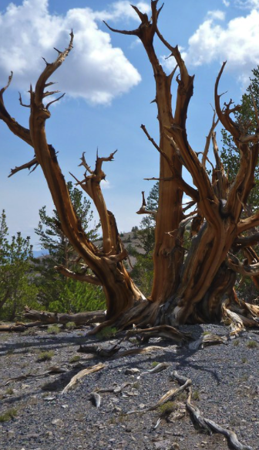
Data Info
Each observation is a 30m x 30m patch of forest.
Target value: Cover Type
(1) Spruce/Fir (2) Lodgepole Pine (3) Ponderosa Pine (4) Cottonwood/Willow
(5)Aspen (6) Douglas-fir (7) Krummholz
Notes:
> The dataset was retrieved from UCI Machine Learning Repository.
> The dataset is 501812 x 54

Slide 5
Data Info
Explanatory Variables
continuous
Terrain
Elevation (m)
Aspect (azimuth)
Insolation Duration
Hillshade_9am (0 to 255 index)
Distance
Slope (degree)
Horizontal Distance to Hydrology (m)
Vertical Distance to Hydrology (m)
Horizontal Distance to Roadways （m）
Hillshade_Noon (0 to 255 index)
Location
Hillshade_3pm (0 to 255 index)
4 Wilderness Areas (0 absence or 1 presence)
Soil Type
40 Soil Types (0 absence or 1 presence)
continuous
continuous
continuous
binary (categorical)
binary (categorical)

Slide 6
Data Wranggling
Download data from UCI Machine Learning Repository
Original data had 501,812 rows and 54 columns
No missing values were found
Data was well structured and tidy.
Found suspicious values: the Vertical_Distance_To_Hydrology
had near 20% percent values negative; assume it took the
direction into account, so keep them intact.
Notes:
Vertical_Distance_To_Hydrology explaines the vertical distance from the sample forest to its nearest surface water.
The elevation of the patch of forest could be either higher or lower than the elevation of the surface water, resulting in positive or negative values. In addition, near 20% values were negative, ranging from -173 to 0. This information should give strong evidence that the negative data were not caused by input error.

Slide 7
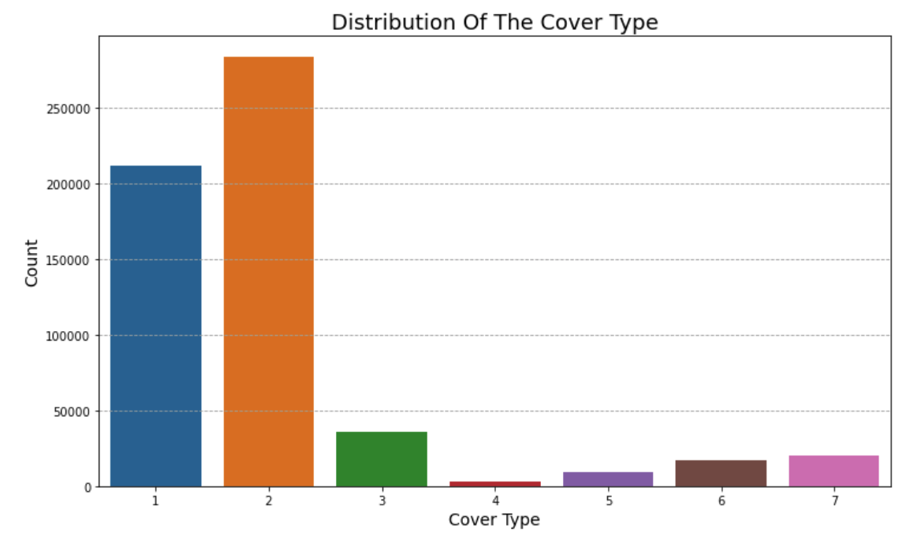
Data Exploratory Analysis
Problem of Class Imbalance
Cover Type 2 (Lodgepole Pine): 48.76%
Cover Type 1 (Spruce/Fir): 36.46%
Cover Type 3 (Ponderosa Pine): 6.15%
Cover Type 7 (Krummholz): 3.53%
Cover Type 6 (Douglas-fir): 2.99%
Cover Type 5 (Aspen): 1.63%
Cover Type 4 (Cottonwood/Willow): 0.47%
Notes:
Most machine learning model assume the data distributed equally.
The model tends to be more biased to the majority classes such as Cover Type 1 and 2 in our case.
Such that, I addressed this issue by resampling the data.

Slide 8
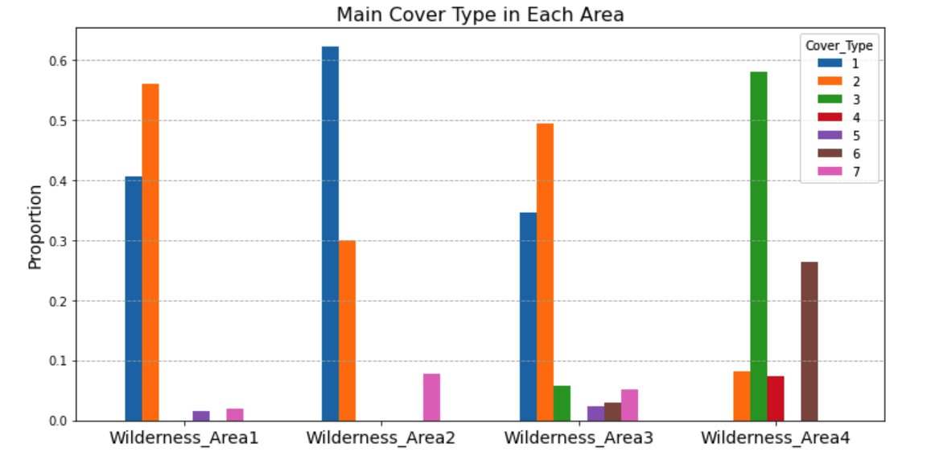
Data Exploratory Analysis
Predominant Cover Type in Different Areas
In Wilderness Area 1, 2 , 3: Main cover
types are 1 and 2
In Wilderness Area 4: Main cover
types are 3 and 6
Only cover type 2 appears in all
Wilderness Areas.(More adaptive?)
Notes:
the elevation of Wilderness_Area4 has the lowest elevation compared to the other areas. Its mean elevation is close 2300m, far less than Wilderness_Area1 and Wilderness_Area3’s 3000m and Wilderness_Area2’s 3200m. Cover_Type3 and 6 might probably favor middle elevation over high elevation. Another thing we found was that Wilderness_Area4 has the shortest average horizontal distance to fire points, given its mean equals to 779m, at least twice smaller than the others. This may suggest that cover type 3 and 5 grow in a drier environment and they are relatively drought tolerant.

Slide 9
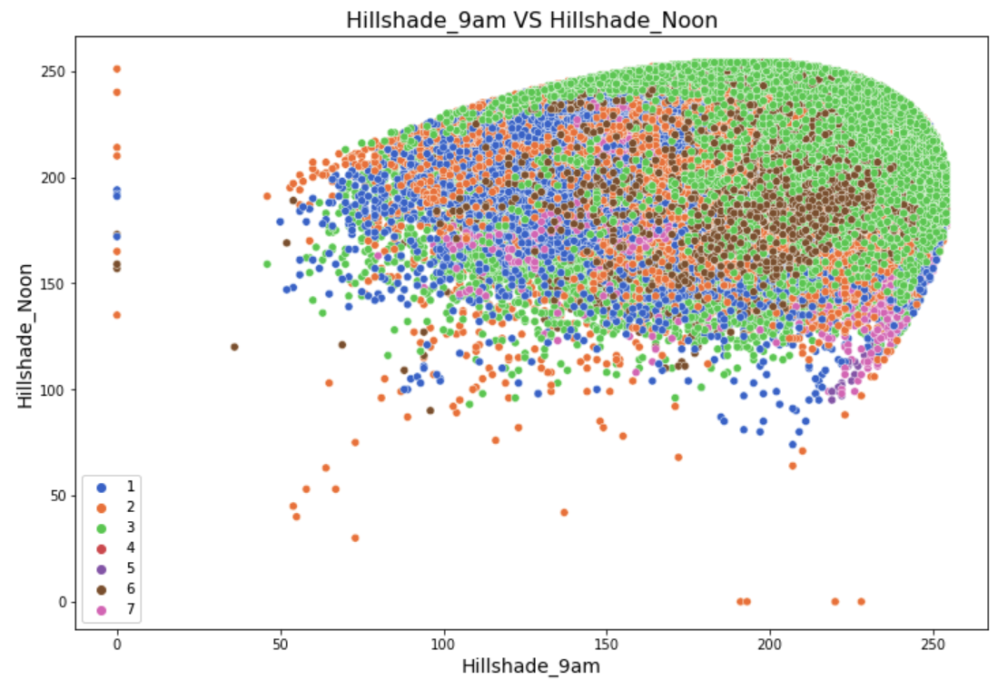
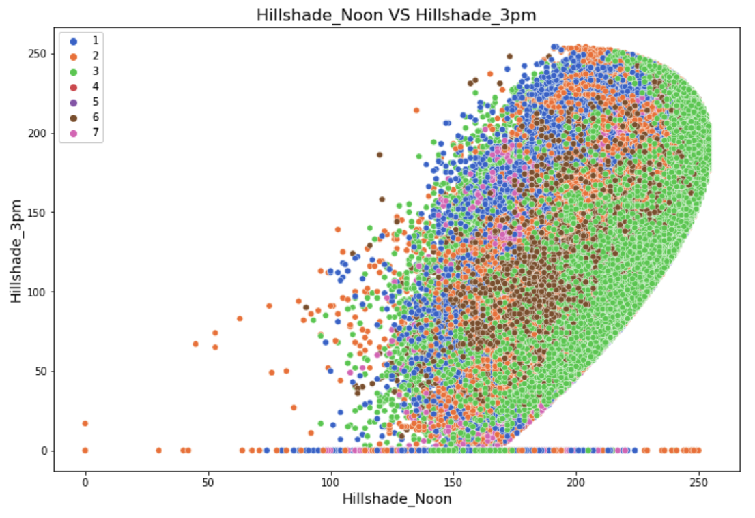
Data Exploratory Analysis
Insolation Duration
Notes:
> All these seven cover types seem to favor the sunlight over the shade.
> Cover_Type3 and Cover_Type2 spread in a wider range, which may suggest they favor the sunlight but are shade tolerant meanwhile.

Slide 10
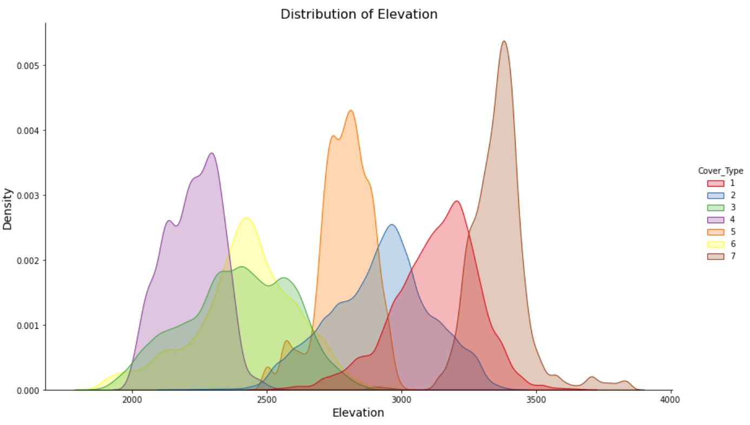
Data Exploratory Analysis
Distribution of Elevation by Cover Type
Strong variation on the distributions,
indicating that elevation is a very
useful predictor.
Wider range: more adaptable to climate
change, vice versa.

Slide 11
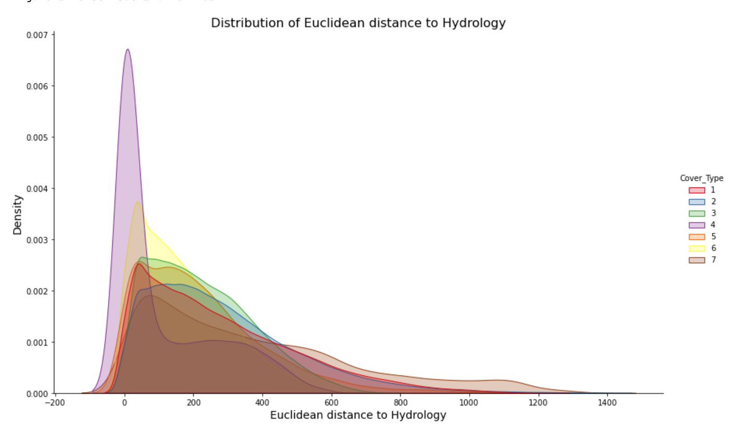
Data Exploratory Analysis
Distribution of Euclidean Distance to Hydrology
Based on the vertical and horizontal
distance to hydrology, I created the
euclidean distance to hydrology.
All right skewed --> Thrive in moisture
Cover type 4: needs more water or
drought intolerant.

Slide 12
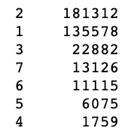
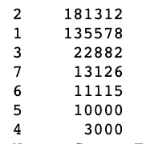
Model Selection
Some Background
64% Training Set
16% Validation Set
20% Test Set
Metric used to measure the performance: Macro Average F1-score
4 Candidate Models
The Resampling method we used is Borderline-SMOTE.
Decision Tree Model W/O Resampling
Decision Tree Model W/ Resampling
Random Forest Model W/O Resampling
Random Forest Model W/Resampling
Old Data(Training)
New Data(Training)
Notes:
>The reason why macro F1-score is good option for case is it gives the same importance to each class. It will give a low score for models that only perform well on majority classes while perform poor on the minority classes. Meanwhile, it guarantees precision and recall balance.
> Borderline-SMOTE only makes synthetic data along the boundary between the two classes.

Slide 13
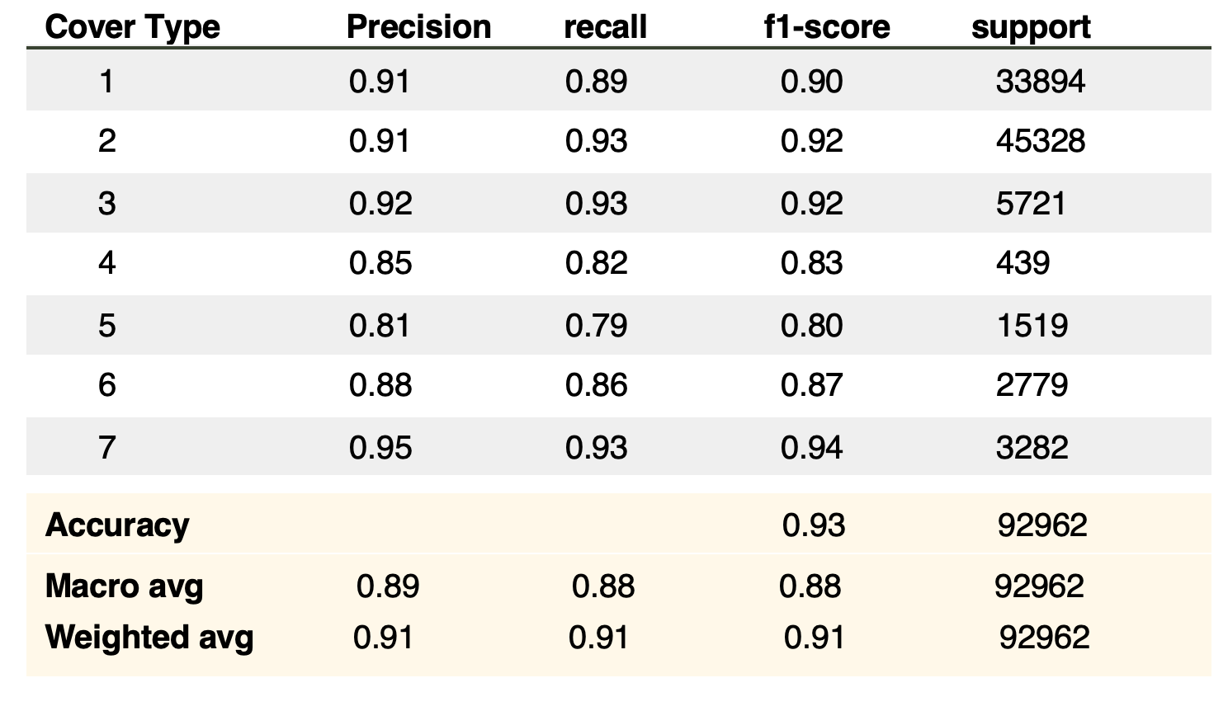
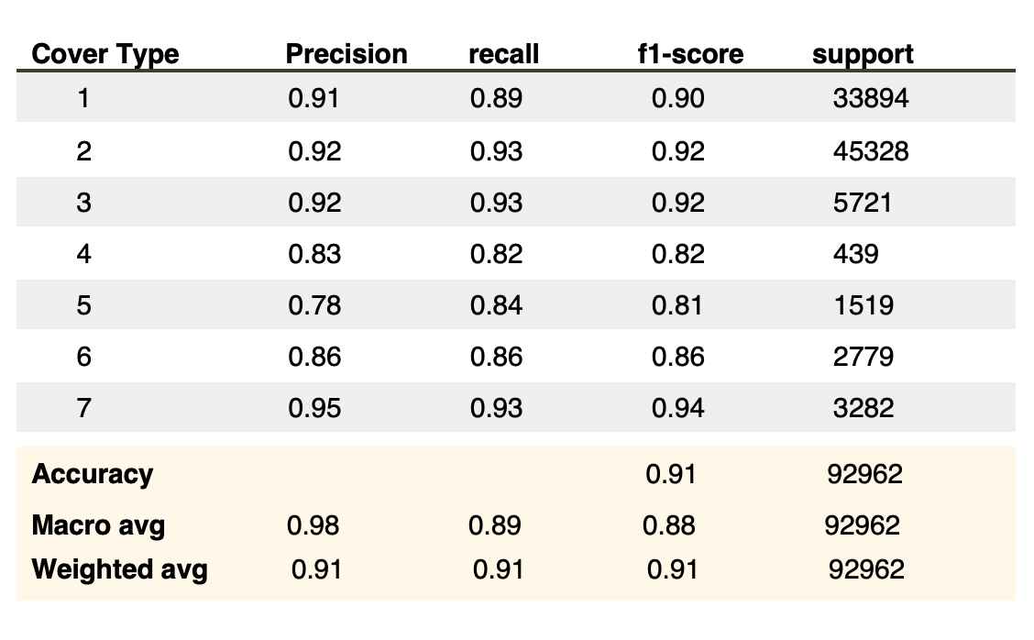
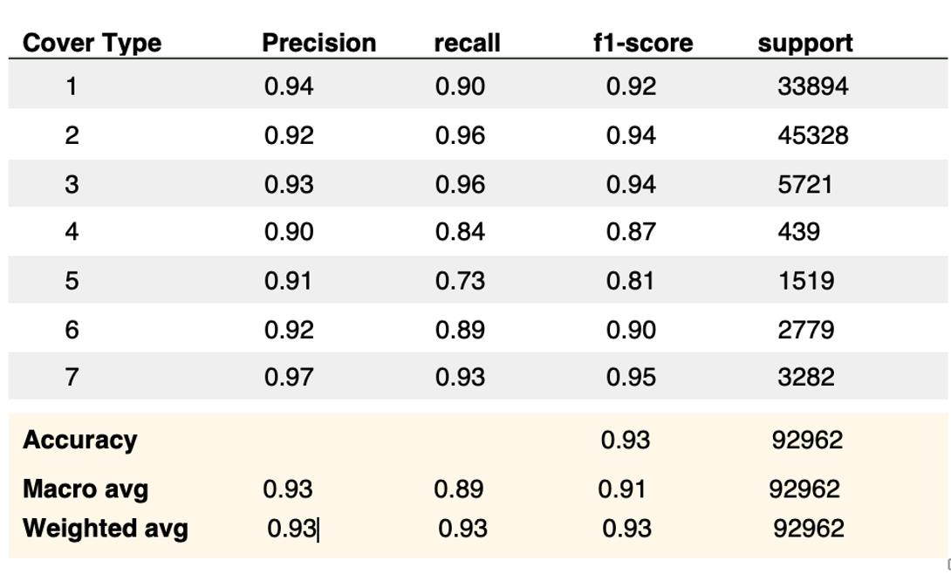
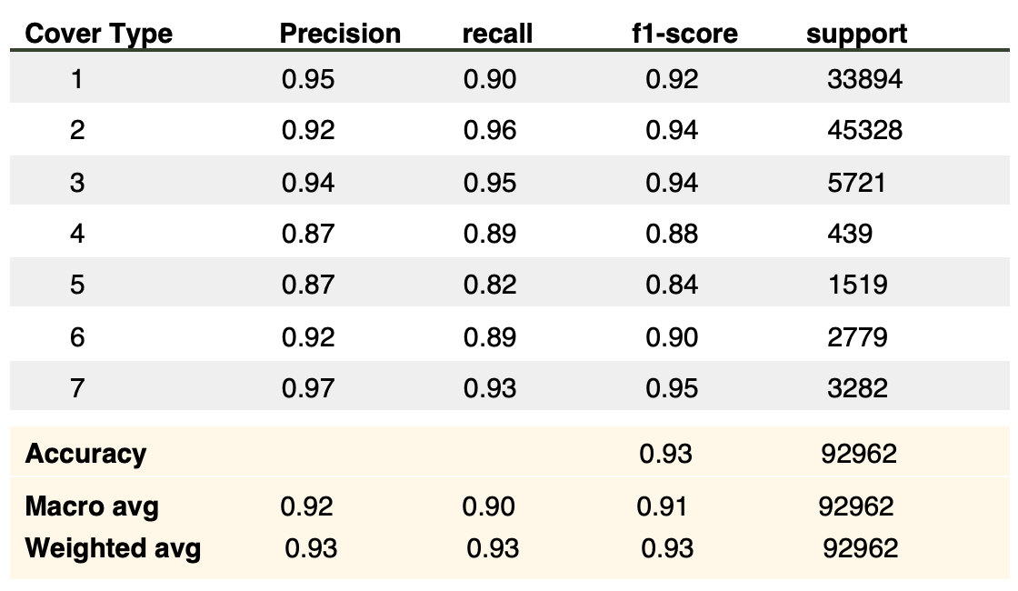

Without Resampling
With Resampling
Model 1: Decision Tree W/O Resampling
Model 2: Decision Tree W/ Resampling
Model 3: Random Forest W/O Resampling
Model 4: Random Forest W/ Resampling
Notes:
>Both of the random forest models have the same macro f1-score 0.91 and accuracy 0.93 on the validation set, comparing to 0.88 and 0.93 of the decision tree model without resampling and 0.88 and 0.91 of the decision tree model with resampling.
>Moreover, the random forest models seem to have a slightly better generalization ability on the unseen data since they have a smaller difference in macro f1 scores on the training set and the validation set.

Slide 14
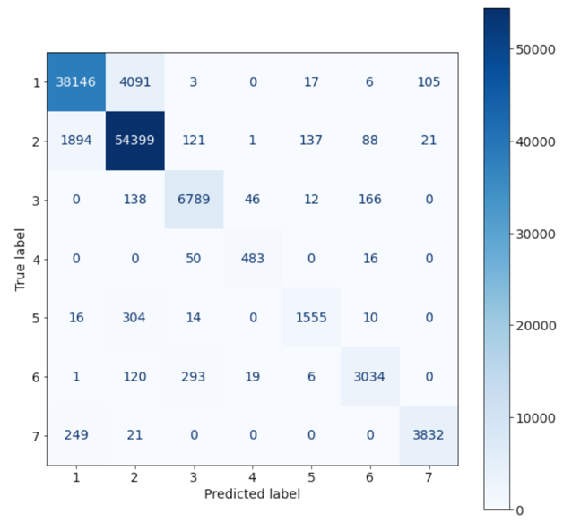
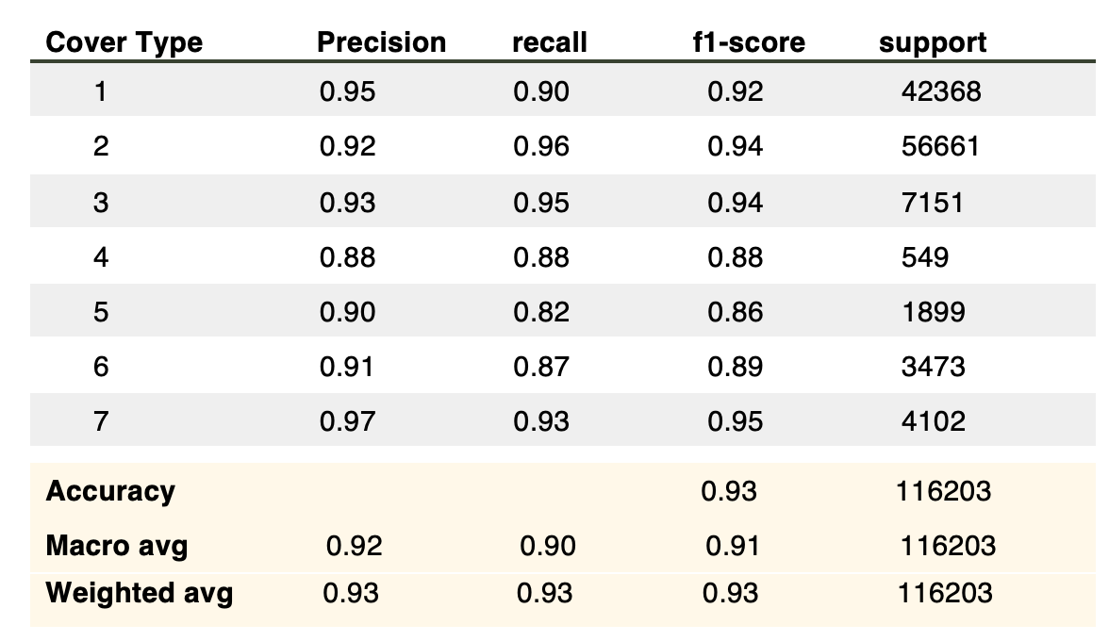
Results
Results on the test set
Confusion Matrix
The scores on the test set are close to the validation set!
Same macro avg f1-score and marco accuracy!
Performance on the minority classes 4 and 6 are stable.
Notes:
The test scores are very satisfying and are close to the scores of the validation set. The macro average f1-score and accuracy on the test set are 0.91 and 0.93, which are same as the validation set. The performance on the minority Cover_Type4, 5 and 6 are very stable as well. The recall scores of Cover_Type4 and Cover_Type6 drop 0.01 and 0.02 respectively while the recall score on the Cover_Type5 remains unchanged. The performance on the majority classes are just as good as usual, with f1-scores, recalls, precisions are all above 0.90.

Slide 15
Summary
The main cover types in Different Wilderness Areas vary due to their local environmental conditions.
The elevation matters the most.
Cover types 3 and 2 are most adaptive to changing environment.
Random Forest Model with resampling is the best model.

Slide 16
THANK YOU!

